Slide 1
EMBRACING UNIVERSALVALUES:EXPLORING LOVE TRUTH AND PEACE IN EVERYDAY LIFE
BY
RAKSHANA DEVI S
22BCC043

Slide 2
INTRODUCTION
Values are an inevitable and crucial component in making significant decisions within the realm of human affairs.
Although the prevalence of violence, war, hatred, and crime in many societies throughout history might seem to challenge the universality of human values.
it is noteworthy that values have their origins in the earliest documented human societies and religions, persisting across eras and cultures.

Slide 3
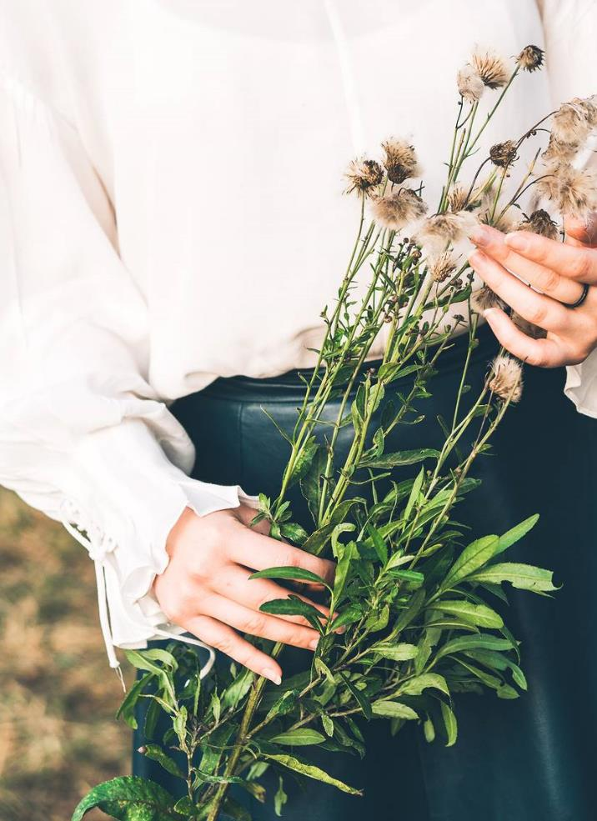
HUMAN VALUE CONSISTS:
Human values can take diverse forms, ranging from concrete illustrations to overarching moral principle . Some of the human values that possess a broad and perhaps even universal significance include:
Truth
Love and Caring
Peace
Responsibility
Justice
They serve as the bridge that connects personal perceptions, judgments, motives, and actions. This principle also holds true when it comes to comprehending social and political aspects of life.

Slide 4
EXAMPLE
Friendship: it is the esteem between people that allows them to establish much closer bonds of coexistence. Sardonically Ambrose Bierce (1906) exposes that friendship in the following way: a boat large enough to carry two in good weather, but only one in the event of a storm.
Confidence: feeling of security in oneself towards a person or thing.
Love: it is a manifestation of living beings towards everything that represents beauty and good. An example of this common goal towards beauty is the ability to actively work for my freedom and that of another, although that freedom does not include someone else, we decided to share it.

Slide 5
CONCLUSION
The very name of -universal values- alludes to how wide the field of application of these is, since they are not limited only to known people, cultures, ideals and ways of living. Universal values ​​can be applied in any geographic region and in quite particular and not precisely structured ways; universal values ​​are applied in those details that pursue the basic principle of life: truth.

Slide 6
Thank you

